Slide 1

Python Programming
(Business & Analytics)
by Su Lee Seng,
Jan, 2021

Slide 2

Python Programming
(Business & Analytics)
by Su Lee Seng,
Jan, 2021

Slide 3
Talk is cheap.
show me the code.

Slide 4

SAP HANA – An Introduction
@ UTAR
by Su Lee Seng,
April, 2014.

Slide 5
Python Programming
Numbers, Booleans and None

Slide 6
Python Programming – Number, Booleans and None :
Types of Numbers
There are three types used to represent numbers in Python; these are integers (or integral) types, floating point numbers and complex numbers. Why ??
This actually comes down to efficiency in terms of both the amount of memory needed to represent a number and the amount of processing power needed to work with that number. In essence integers are simpler to work with and can take up less memory than real numbers. Integers are whole numbers that do not need to have a fractional element. When two integers are added, multiplied or subtracted they will always generate another integer number.

Slide 7
Python Programming – Number, Booleans and None :
Types of Numbers
In Python real numbers are represented as floating point numbers (or floats). These can contain a fractional part (the bit after the decimal point). Computers can best work with integers (actually of course only really 1s and 0s). They therefore need a way to represent a floating point or real number. Typically this involves representing the digits before and after the decimal point.
The term floating point is derived from the fact that there is no fixed number of digits before or after the decimal point; that is, the decimal point can float. Indeed, most floating-point numbers are actually represented as approximations.

Slide 8
Python Programming – Number, Booleans and None :
Types of Numbers
This means that one of the challenges in handling floating-point numbers is in ensuring that the approximations lead to reasonable results. If this is not done appropriately, small discrepancies in the approximations can snowball to the point where the final results become meaningless.
As a result, most computer programming languages treat integers such as 4 as being different from real numbers such as 4.000000004.
Complex numbers are used in electronics and electromagnetism.

Slide 9
Python Programming – Number, Booleans and None :
Integers
x = 1
print(x)
print(type(x))
x =
100000000000000000000000000000000000000000000000000000000001
print(x)
print(type(x))
Output :
1
<class 'int'>
100000000000000000000000000000000000000000000000000000000001
<class 'int'>

Slide 10
Python Programming – Number, Booleans and None :
Integers
This makes it very easy to work with integer numbers in Python. Unlike some programming languages such as C# and Java have different integer types depending on the size of the number, small numbers having to be converted into larger types in some situations.

Slide 11
Python Programming – Number, Booleans and None :
Converting to Ints
total = int('100')
This can be useful when used with the input() function.
The input() function always returns a string. If we want to ask the user to input an integer number, then we will need to convert the string returned from the input() function into an int. We can do this by wrapping the call to the input() function in a call to the int() function, for example:
age = int(input('Please enter your age:'))
print(type(age))
print(age)
Output :
Please enter your age: 21
<class 'int'>
21
Notes:
The int() function can also be used to convert a floating point number into an int, for example:
i = int(1.0)

Slide 12
Python Programming – Number, Booleans and None :
The Input function
print(‘ Please Enter the Number:’)
X = input()
print(‘ Entered Number is: ‘,X)
print(‘ Type of X is:’)
print(type(X))
Num1 = int(input(‘ Please Enter Number:’))
print(‘ Num1 = ‘,Num1) #Print the value of Num1
print(type(Num1)) #Check type of Num1
Output :
Please Enter the number:
60
Entered Number is: 60
Type of X is:
<class ‘str’>
Output :
Please Enter Number:
20
Num1 = 20
<class ‘int’>
Notes:
The int() function can also be used to convert a floating point number into an int, for example:
i = int(1.0)

Slide 13
Python Programming – Number, Booleans and None :
The eval() function
By making use of eval() function, we can avoid specifying a particular type in front of input() function. Thus, the above statement,
X = int (input(‘Enter the Number’))
can be written as:
X = eval(input(‘Enter the Number’))
With respective to the above statement, a programmer does not know what values a user can enter. He/she may enter a value of any type, i.e. int, float, string, complex etc. By making use of eval, Python automatically determines the type of value entered by the user.

Slide 14
Python Programming – Number, Booleans and None :
Floating Point Numbers
The type used to represent a floating point number is called float.
Python represents floating point numbers using a decimal point to separate the whole part from the fractional part of the number, for example:
exchange_rate = 1.83
print(exchange_rate)
print(type(exchange_rate))
Output :
1.83
<class 'float'>

Slide 15
Python Programming – Number, Booleans and None :
Converting to Floats
As with integers it is possible to convert other types such as an int or a string into a float. This is done using the float() function:
int_value = 1
string_value = '1.5'
float_value = float(int_value)
print('int value as a float:', float_value)
print(type(float_value))
float_value = float(string_value)
print('string value as a float:',
Output :
int value as a float: 1.0
<class 'float'>
string value as a float: 1.5
<class 'float'>

Slide 16
Python Programming – Number, Booleans and None :
Converting an Input String into a Floating Point Number
exchange_rate = float(input("Please enter the exchange rate to use: "))
print(exchange_rate)
print(type(exchange_rate))
Using this we can input the string 1.83 and convert it to a floating-point number:
Output :
Please enter the exchange rate to use: 1.83
1.83
<class 'float'>

Slide 17
Mumbers, Boolean and None
Boolean

Slide 18
Python Programming – Number, Booleans and None :
Boolean Values
Python supports another type called Boolean; a Boolean type can only be one of True or False (and nothing else). Note that these values are True (with a capital T) and False (with a capital F); true and false in Python are not the same thing and have no meaning on their own.

Slide 19
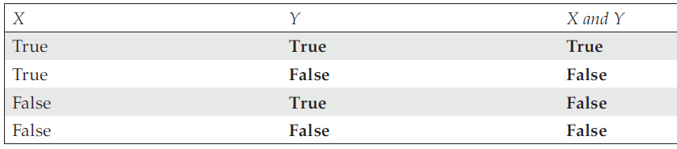
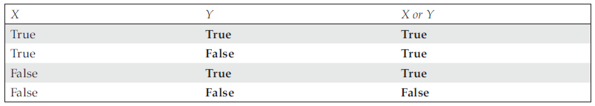
Python Programming – Number, Booleans and None :
Boolean Operators
xx

Slide 20
Python Programming – Number, Booleans and None :
Using Numbers with Boolean Operators
>>> not 1
False
>>> 5
5
>>> not 5
False
>>> not 0
True
>>> not 0.0
True
In case of the numbers 0 and 0.0, Python treats them as False…all other numbers are treated as True.
Notes:
Explanation Here, Python uses the Boolean operator not on the numbers and treats all numbers as True. Therefore, by writing not 1, Python substitutes 1 as True and evaluates not True, which returns False. Similarly, not is used before 5 and Python substitute True in place of 5 and it again evaluates the expression not True, which returns False. But in case of the numbers 0 and 0.0, Python treats them as False. Therefore, while evaluating not 0, it substitutes False in place of 0 and again evaluates the expression not False, which returns True.

Slide 21
Python Programming – Number, Booleans and None :
Using Strings with Boolean Operators
>>> not ‘hello’
False
>>> not ‘’
True
Python treats all strings as True
Notes:
Explanation Here, Python uses the Boolean operator not on string. The expression not hello returns True since Python treats all strings as True. Therefore, it substitutes True in place of ‘hello’ and again reevaluates the expression not True, which returns False. However, if it is an empty string, Python will treat it as False. Therefore, it substitutes False in place of an empty string ‘’and reevaluates the expression not False, which in turn returns True.

Slide 22
Python Programming – Number, Booleans and None :
Boolean Values
The equivalent of the int or float class for Booleans is bool. The following example illustrates storing the two Boolean values into a variable all_ok:
all_ok = True
print(all_ok)
all_ok = False
print(all_ok)
print(type(all_ok))
Output :
True
False
<class 'bool'>

Slide 23
Python Programming – Number, Booleans and None :
Boolean Values
print(int(True))
print(int(False))
print(bool(1))
print(bool(0))
You can also convert strings into Booleans as long as the strings contain either True or False (and nothing else). For example:
status = bool(input('OK to proceed: '))
print(status)
print(type(status))
Output :
1
0
True
False
Output :
OK to proceed: True
True
<class 'bool'>

Slide 24
Mumbers, Boolean and None
Arithmetic Operators

Slide 25
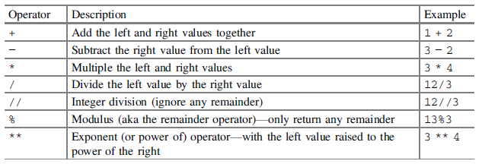
Number, Booleans and None - Arithmetic Operators :
Arithmetic Operators
xxxx

Slide 26
Number, Booleans and None - Arithmetic Operators :
Integer Operations
home = 10
away = 15
print(home + away)
print(type(home + away))
print(10 * 4)
print(type(10*4))
goals_for = 10
goals_against = 7
print(goals_for - goals_against)
print(type(goals_for - goals_against))
Output :
25
<class 'int'>
40
<class 'int'>
3
<class 'int'>

Slide 27
Number, Booleans and None - Arithmetic Operators :
Integer Operations
print(100 / 20)
print(type(100 / 20))
res1 = 3/2
print(res1)
print(type(res1))
Output :
5.0
<class 'float'>
Output :
1.5
<class 'float'>
Notes:
And as you can see from this the type of the result is float (that is a floating point number). So why is this the case?
The answer is that division does not know whether the two integers involved divide into one another exactly or not (i.e. is there a remainder). It therefore defaults to producing a floating point (or real) number which can have a fractional part.

Slide 28
Number, Booleans and None - Arithmetic Operators :
Integer Operations
If you are only interested in the number of times 2 does go into 3 and are happy to ignore the fractional part then there is an alternative version of the divide operator //. This operator is referred to as the integer division operator:
res1 = 3//2
print(res1)
print(type(res1))
print('4 % 2:', 4 % 2)
print('3 % 2:', 3 % 2)
print(10 % 4)
print(13%5)
Output :
1
<class 'int'>
Output :
4 % 2: 0
3 % 2: 1
2
3

Slide 29
Number, Booleans and None - Arithmetic Operators :
Integer Operations
Power operator that can be used to raise an integer by a given power, for example 5 to the power of 3. The power operator is '**', this is illustrated below:
a = 5
b = 3
print(a ** b)
In Python, spaces after a number or symbol do not carry any meaning. So, 5**3 and 5 ** 3 both result in 125.
Spaces are meant to enhance readability. Although there is no correct way to space code, spaces are generally encouraged between operands and operators. Thus, 5 ** 3 is preferable.
Output :
125
Notes:
Trying to follow certain conventions is perfectly acceptable. If you develop good habits early on, it will make the reading and debugging of code easier later.

Slide 30
Number, Booleans and None - Arithmetic Operators :
Negative Number Integer Division
Output :
True division 3/2: 1.5
True division -3/2: -1.5
Integer division 3//2: 1
Integer division -3//2: -2
print('True division 3/2:', 3 / 2)
print('True division -3/2:', -3 / 2)
print()
print('Integer division 3//2:', 3 // 2)
print('Integer division -3//2:', -3 // 2)
>>> 4//2 # Floor Division
2
>>> 10//3 #Floor Division
3
Python pulls the result of the integer division to the smallest possible number, 1 is smaller than 1.5 but −2 is smaller than −1.5
Notes:
Why does 3//2 generate 1 but −3//2 generates −2?
The answer is that Python always rounds the result of integer division towards minus infinity (which is the smallest negative number possible). This means it pulls the result of the integer division to the smallest possible number, 1 is smaller than 1.5 but −2 is smaller than −1.5

Slide 31
Number, Booleans and None - Arithmetic Operators :
Floating Point Number Operators
print(2.3 + 1.5)
print(1.5 / 2.3)
print(1.5 * 2.3)
print(2.3 - 1.5)
print(1.5 - 2.3)
Output :
3.8
0.6521739130434783
3.4499999999999997
0.7999999999999998
-0.7999999999999998

Slide 32
Number, Booleans and None - Arithmetic Operators :
Integer and Floating Point Operations
Any operation that involves both integers and floating point numbers will always produce a floating point number. That is, if one of the sides of an operation such as add, subtract, divide or multiple is a floating point number then the result will be a floating point number.
i = 3 * 0.1
print(i)
Floating point (or real) numbers are represented as an approximation within a computer system. If this was part of a larger calculation (such as the calculation of the amount of interest to be paid on a very large loan over a 10 year period) then the end result might well be out by a significant amount.
Output :
0.30000000000000004
Notes:
Floating point (or real) numbers being represented as an approximation within a computer system. If this was part of a larger calculation (such as the calculation of the amount of interest to be paid on a very large loan over a 10 year period) then the end result might well be out by a significant amount
It is possible to overcome this issue using one of Pythons modules (or libraries). For example, the decimal module provides the Decimal class that will appropriately handle multiplying 3 and 0.1.

Slide 33
Mumbers, Boolean and None
Assignment Operators

Slide 34
Number, Booleans and None - Assignment Operators :
Assignment Operators
These assignment operators are actually referred to as compound operators as they combine together a numeric operation (such as add) with the assignment operator. For example, the += compound operator is a combination of the add operator and the = operator such that
x = 0
x += 1 # has the same behaviour as x = x + 1
Some developers like to use these compound operators as they are more concise to write and can be interpreted more efficiently by the Python interpreter.

Slide 35
Number, Booleans and None - Assignment Operators :
Example : Swapping Values
Consider the following statements to swap the values of the two variables P and Q. :
>>> P = 20
>>> Q = 30
>>> Temp = P #Save value of variable P into a variable Temp
>>> P = Q #Assign value of Q to P
>>> Q = Temp #Assign the value of Temp to Q
#After Swapping the value of P, and Q are as follows.
>>> P
>>> Q
Output :
30
20

Slide 36
Number, Booleans and None - Assignment Operators :
Example : Swapping Values
Write a program to calculate the area of a rectangle.
Length = 10
breadth = 20
print(‘ Length = ‘,length,’ Breadth = ‘,breadth)
area = length * breadth
print(‘ Area of Rectangle is = ‘,area)
Output :
Length = 10 Breadth = 20
Area of Rectangle is = 200

Slide 37
Number, Booleans and None - Assignment Operators :
Assignment Operators
>>> some_list = [1, 1, 2, 3]
This assigns a list object, a variable-length sequence of items, to the variable some_list. We can update this list object with an augmented assignment statement:
>>> some_list += [5]
>>> some_list
[1, 1, 2, 3, 5]

Slide 38
Number, Booleans and None - Assignment Operators :
Assignment Operators
In this case, we're actually mutating a single list object, changing its internal state by extending it with items from another list instance. The existing object was updated; this does not create a new object. It is equivalent to using the extend() method:
>>> some_list.extend( [8] )
>>> some_list
[1, 1, 2, 3, 5, 8]

Slide 39
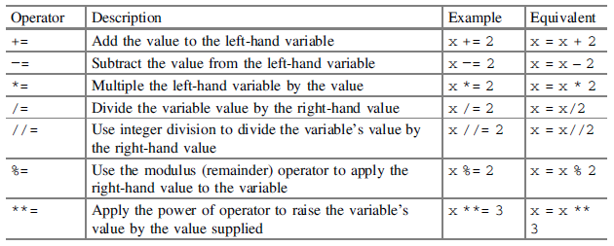
Number, Booleans and None - Assignment Operators :
Assignment Operators
xxxx

Slide 40
Number, Booleans and None - Assignment Operators :
None Value
Python has a special type, the NoneType, with a single value, None. This is used to represent null values or nothingness.
It is not the same as False, or an empty string or 0; it is a non-value. It can be used when you need to create a variable but don’t have an initial value for it. For example:
winner = None
You can then test for the presence of None using 'is' and 'is not', for example:
print(winner is None)
This will print out True if and only if the variable winner is currently set to None.

Slide 41
Number, Booleans and None - Assignment Operators :
None Value
print(winner is not None)
Which will print out True only if the value of winner is not None.

Slide 42
Number, Booleans and None - Assignment Operators :
None Value
winner = None
print('winner:', winner)
print('winner is None:', winner is None)
print('winner is not None:', winner is not None)
print(type(winner))
print('Set winner to True')
winner = True
print('winner:', winner)
print('winner is None:', winner is None)
print('winner is not None:', winner is not None)
print(type(winner))

Slide 43
Number, Booleans and None - Assignment Operators :
None Value
Output :
winner: None
winner is None: True
winner is not None: False
<class 'NoneType'>
Set winner to True
winner: True
winner is None: False
winner is not None: True
<class 'bool'>
winner = None
print('winner:', winner)
print('winner is None:', winner is None)
print('winner is not None:', winner is not None)
print(type(winner))
print('Set winner to True')
winner = True
print('winner:', winner)
print('winner is None:', winner is None)
print('winner is not None:', winner is not None)
print(type(winner))

Slide 44
Number, Booleans and None - Assignment Operators :
Multiple Assignment
>>> brick_red = (203, 65, 84)
We can use brick_red[0] to get the red element of this triple.
We can also do this:
>>> r, g, b = brick_red
>>> r

Slide 45
Number, Booleans and None - Assignment Operators :
Multiple Assignment
We've used multiple assignment to decompose the RGB three-tuple into three individual variables.
Note that Python's syntax flexibility means that we can also do things like this:
>>> n, d = 355, 113
Python allows us to write statements like this: a = b = 0. This must be used carefully, because a single object is now shared by two variables.

Slide 46
Number, Booleans and None - Assignment Operators :
Multiple Assignment
We can use the internal id() function to see if two variables refer to the same underlying object:
>>> a = "string"
>>> b = a
>>> id(a)
4301974472
>>> id(b)
4301974472
From this, we can see that Python variables a and b have references to the underlying object, not copies of the object.

Slide 47
Number, Booleans and None - Assignment Operators :
Using the head, *tail assignment
>>> line = "255 73 108 Radical Red"
>>> line.split()
['255', '73', '108', 'Radical', 'Red']
We have split the string into space-delimited words with line.split(). In this case, the head of the list is the first three fields of the red, green, and blue elements of a color. The tail is all the remaining fields, which is the name parsed into separate words.

Slide 48
Number, Booleans and None - Assignment Operators :
Using the head, *tail assignment
We can use head, *tail = assignment to split the first three fields from the remaining files.
It looks like this:
>>> r, g, b, *name = line.split()
>>> g
'73'
>>> name
['Radical', 'Red']
We've assigned the first three items to three separate variables, r, g, and b. The * means that all of the remaining items will be collected into a single variable, name.

Slide 49
Number, Booleans and None - Assignment Operators :
Using the head, *tail assignment
We can reconstruct the original name with the join() method, with a space as the separator string:
>>> " ".join(name)
'Radical Red' [

Slide 50
Mumbers, Boolean and None
Python Inbuilt Functions

Slide 51
Python Inbuilt Functions :
Inbuilt functions
abs(x) Returns absolute value of x
>>> abs(-2) → Output : 2
>>> abs(4) → Output : 4
max(x1, X2, X3,…………,XN)
min(x1, X2, X3,…………,XN)
pow(X, Y)
round(x)

Slide 52
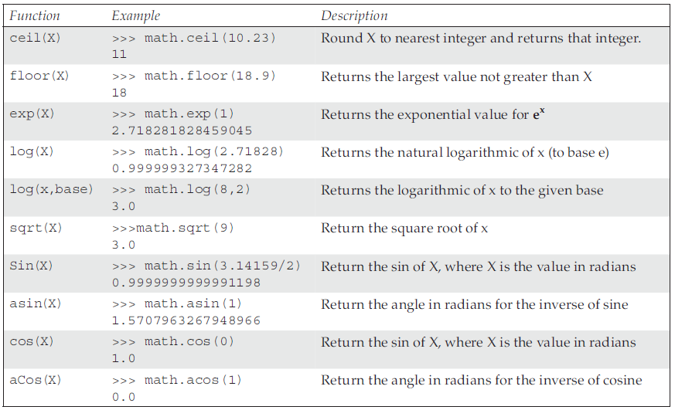
Python Inbuilt Functions :
Inbuilt mathematical functions
xxx

Slide 53
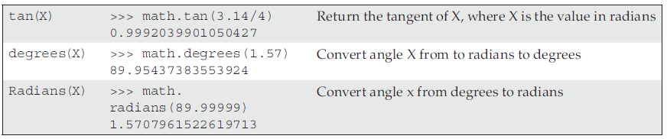
Python Inbuilt Functions :
Inbuilt mathematical functions
xxx

Slide 54
Python Inbuilt Functions :
the ord and chr Functions
Python uses the in-built function ord(ch) to return the ASCII value for a given character.
>>> ord(‘A’) #Returns ASCII value of Character ‘A’
65
>>> ord(‘Z’) #Returns ASCII Value of Character of ‘Z’
90
>>> ord(‘a’) #Returns ASCII Value of Character of ‘a’
97
>>> ord(‘z’) #Returns ASCII Value of Character of ‘z’
122

Slide 55
Python Inbuilt Functions :
the ord and chr Functions
The chr(Code) returns the character corresponding to its code, i.e. the ASCII value. The following example demonstrates the use of in-built function chr().
>>> chr(90)
‘Z’
>>> chr(65)
‘A’
>>> chr(97)
‘a’
>>> chr(122)
‘z’

Slide 56
Number, Booleans and None - Assignment Operators :
Del statement
We can remove variables manually with the del statement. Here's an example:
>>> a = 2**2024
>>> del a
We've created an integer object, and assigned it to the variable a. When we remove the variable, this will reduce the reference count on the integer object. The memory occupied by the big integer is now eligible to be reclaimed.
This kind of thing is done very rarely. Python's ordinary reference counting does almost everything we need. It's generally best not to waste brain calories tying to micro-manage memory allocation.

Slide 57
Math Libraries
Numeric Packages

Slide 58
Number, Booleans and None - Assignment Operators :
Math Libraries
These are the relevant built-in numeric packages:
numbers: This module defines the essential numeric abstractions. We rarely need this unless we're going to invent an entirely new kind of number.
math: This module has a large collection of functions. It includes basic sqrt(), the various trigonometric functions (sine, cosine, and so on) and the various log-related functions. It has functions for working with the internals of floating-point numbers. It also has the gamma function and the error function.
cmath: This module is the complex version of the math library. We use the cmath library so that we can seamlessly move between float and complex values.

Slide 59
Number, Booleans and None - Assignment Operators :
Math Libraries
decimal: Import the Decimal class from this module to work with currency values accurately.
fractions: Import the Fraction class to work with a precise rational fraction value.
Simple Data Types
random: This module contains the essential random number generator. It has a number of other functions to produce random values in various ranges or with various constraints. For example random.gauss() produces a Gaussian, normal distribution of floating-point values.

Slide 60
Number, Booleans and None - Assignment Operators :
Online Resources
See the Python Standard Library documentation for:
• https://docs.python.org/3/library/stdtypes.html#numeric-types-int-float-complex
Numeric Types.
• https://docs.python.org/3/library/stdtypes.html#truth-value-testing Boolean values and boolean testing.
• https://docs.python.org/3/library/decimal.html which provides information on the Python decimal module.
• https://docs.python.org/3/library/cmath.html which discusses mathematical functions for complex numbers.

Slide 61
Number, Booleans and None - Assignment Operators :
Online Resources
If you are interested in how floating point numbers are represented then a good starting points are:
• https://en.wikipedia.org/wiki/Double-precision_floating-point_format which provides an overview of floating point representation.
• https://en.wikipedia.org/wiki/IEEE_754 which is the Wikipedia page on the IEEE 754 Double-precision floating-point number format.
<< Exercise B5 >>

Slide 62
Thank you

